Slide 1
Meeting 12/10/26
FEM and Kalnaus review paper

Slide 2
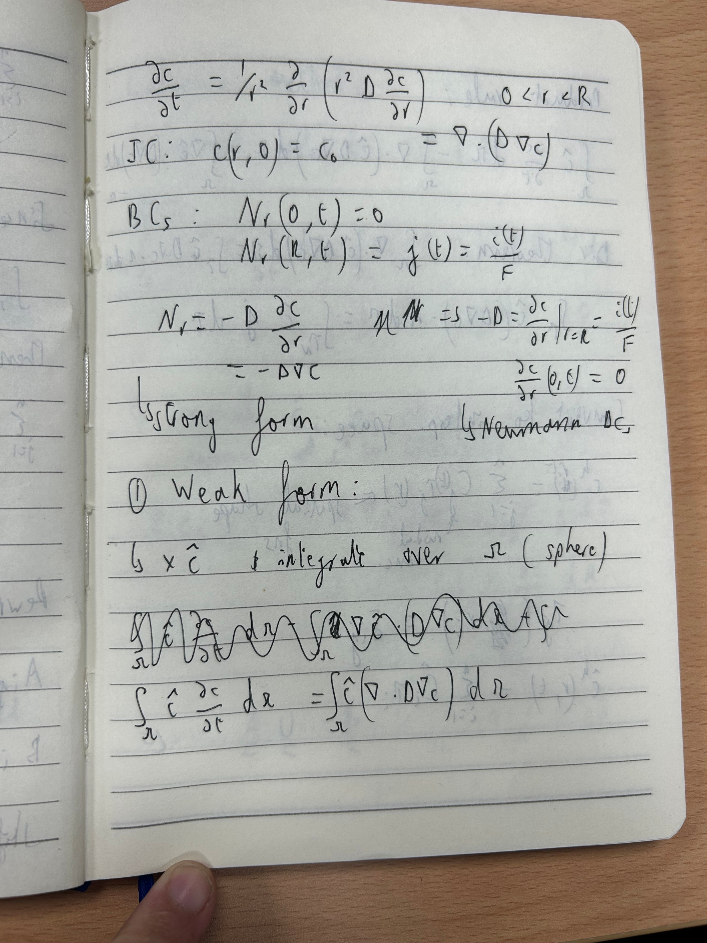
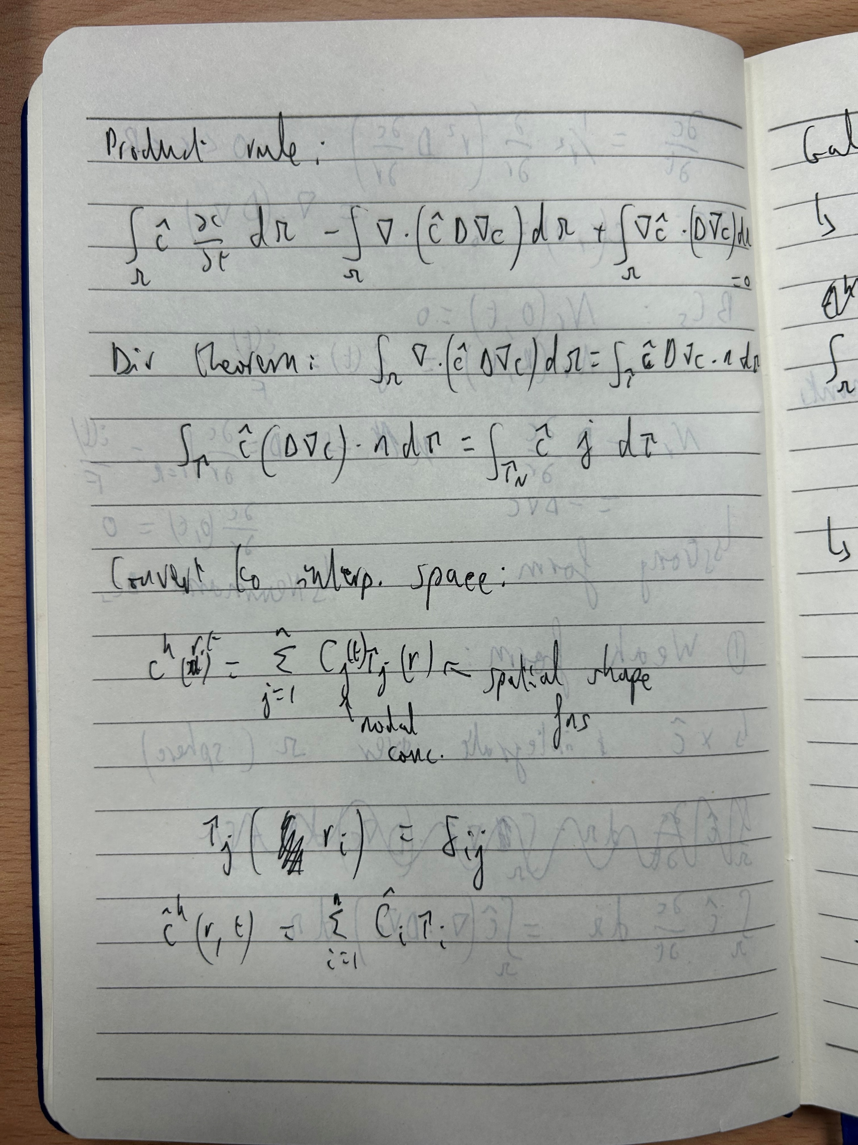
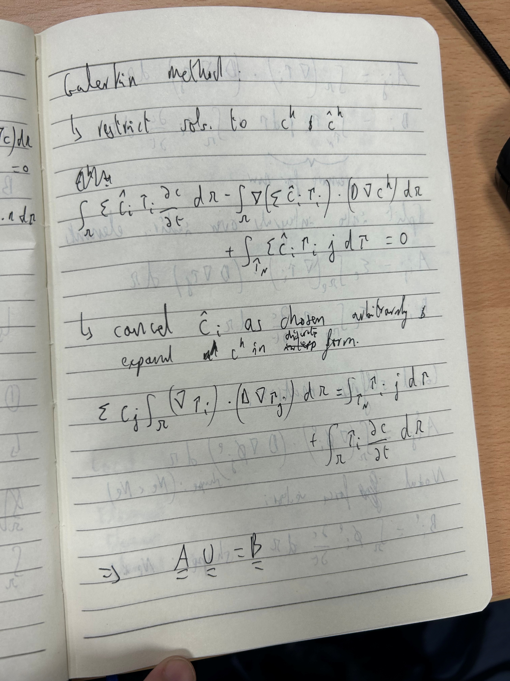
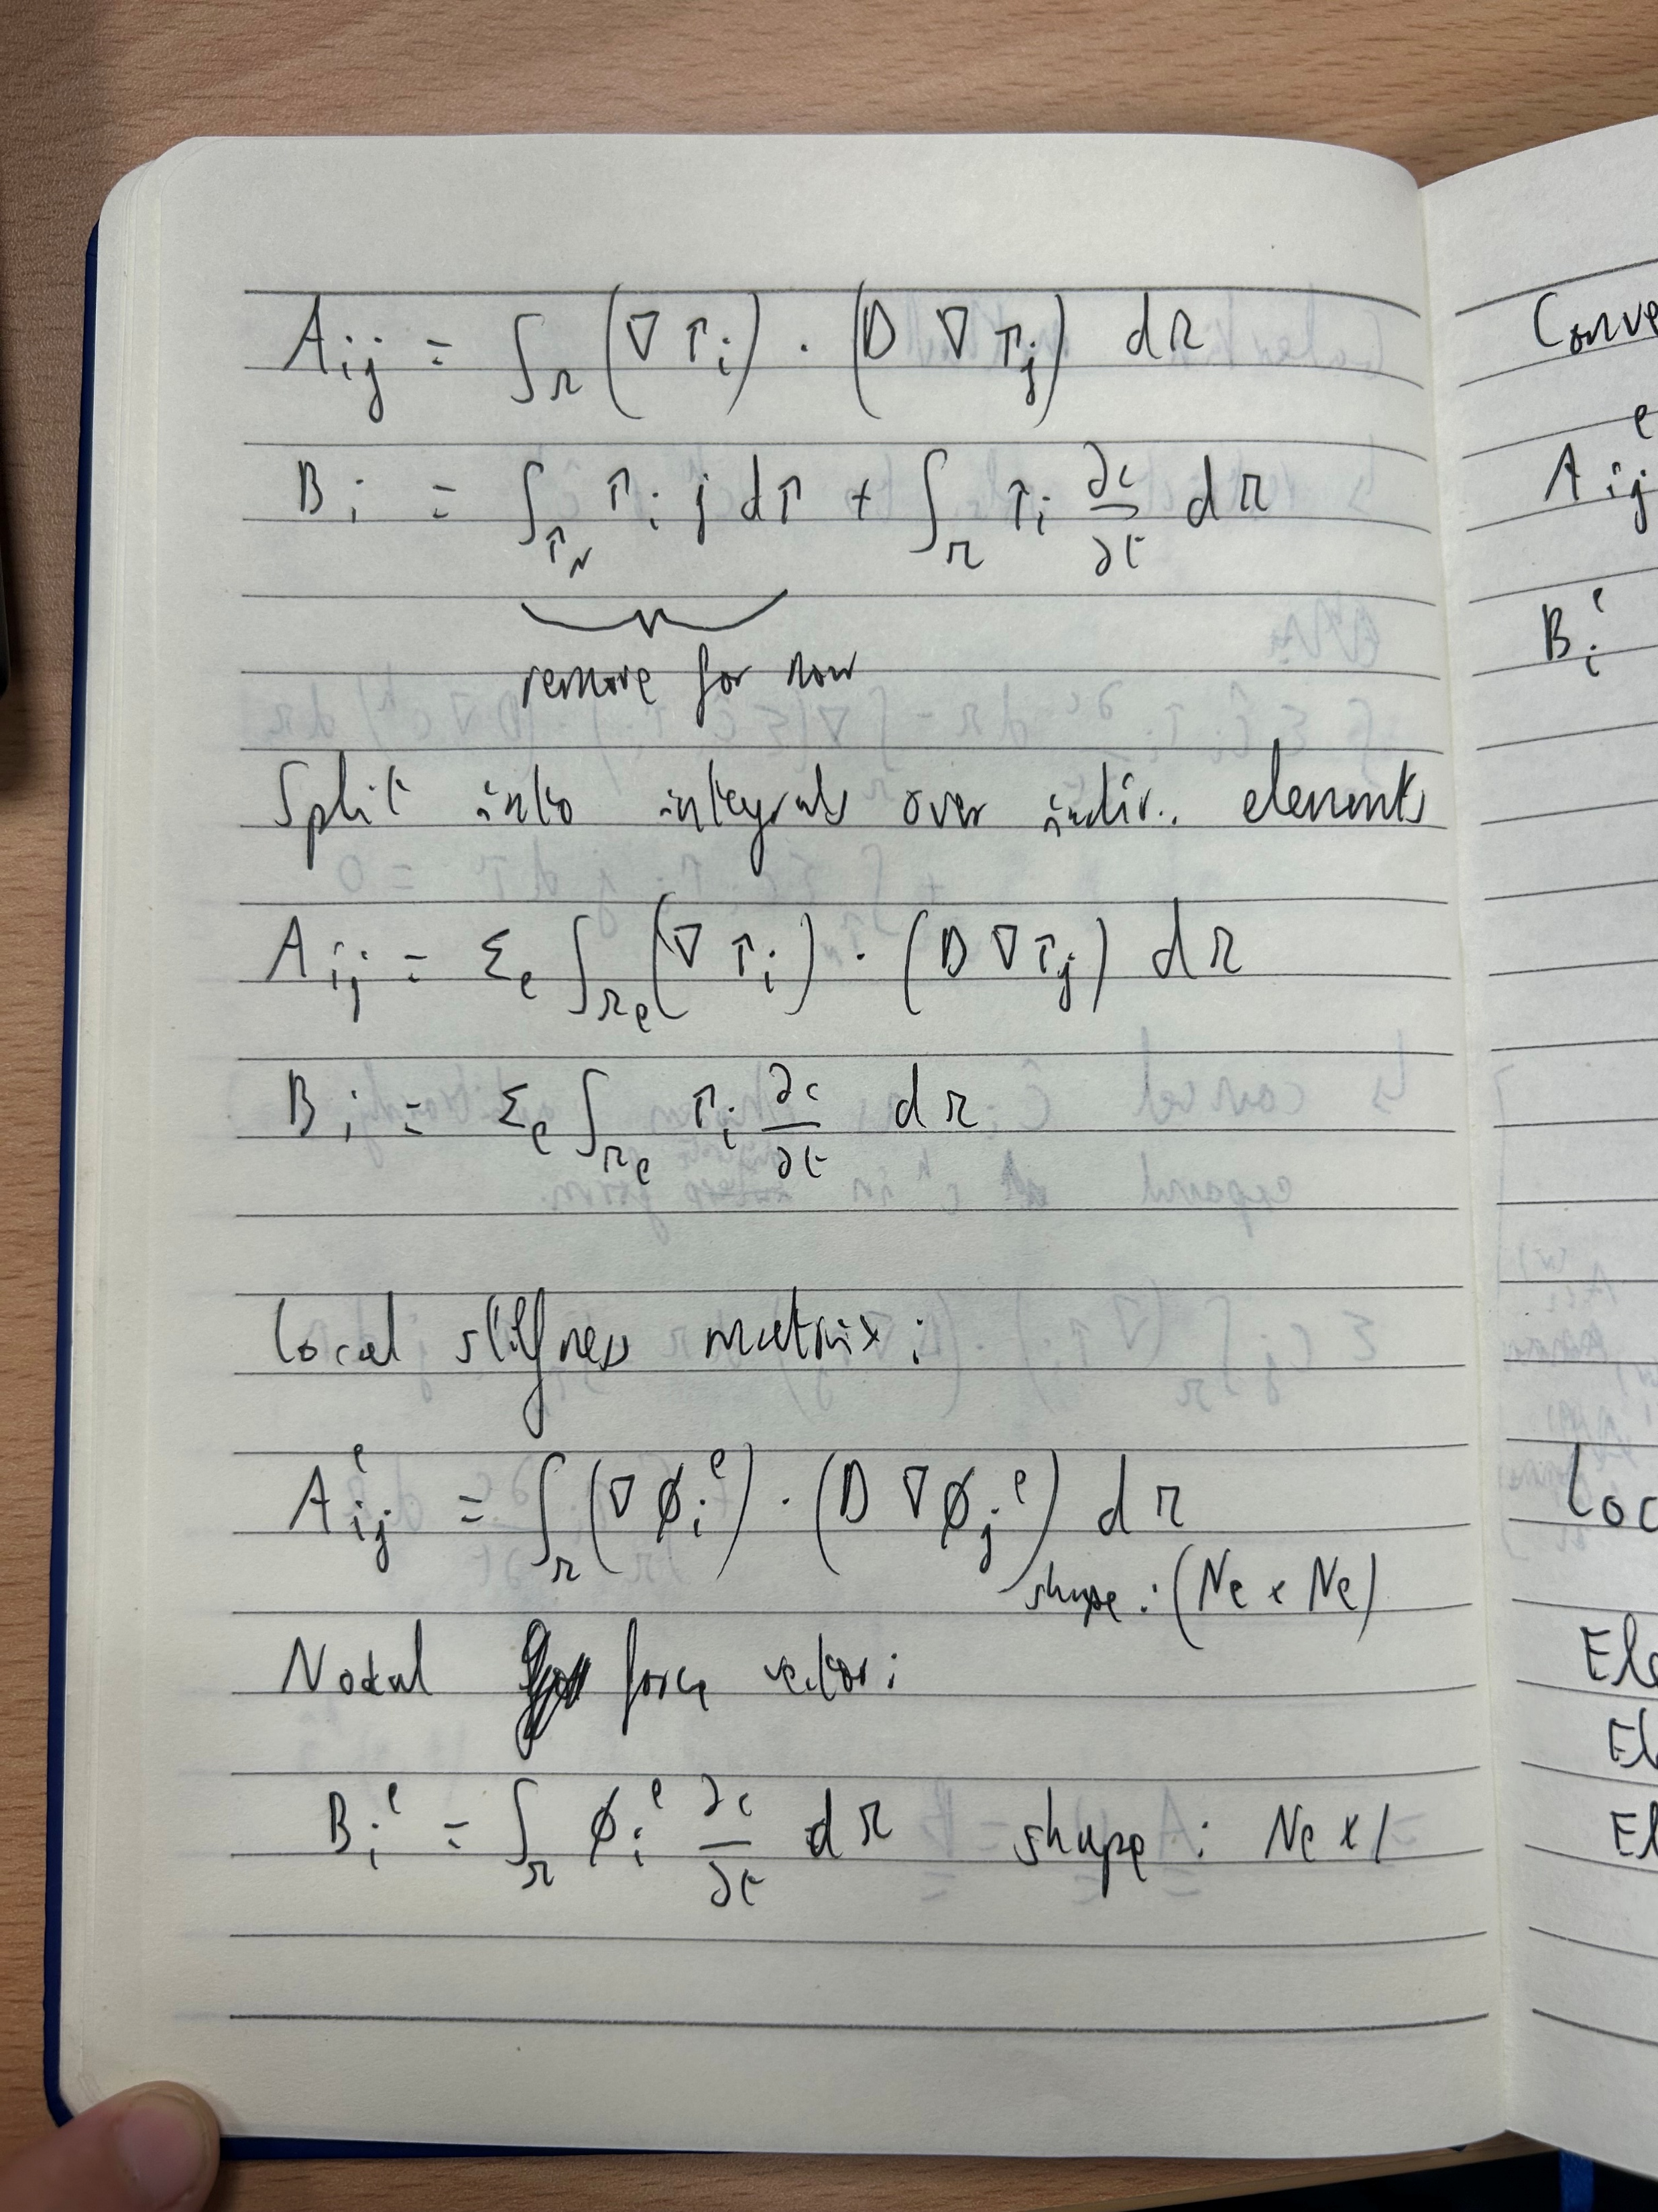
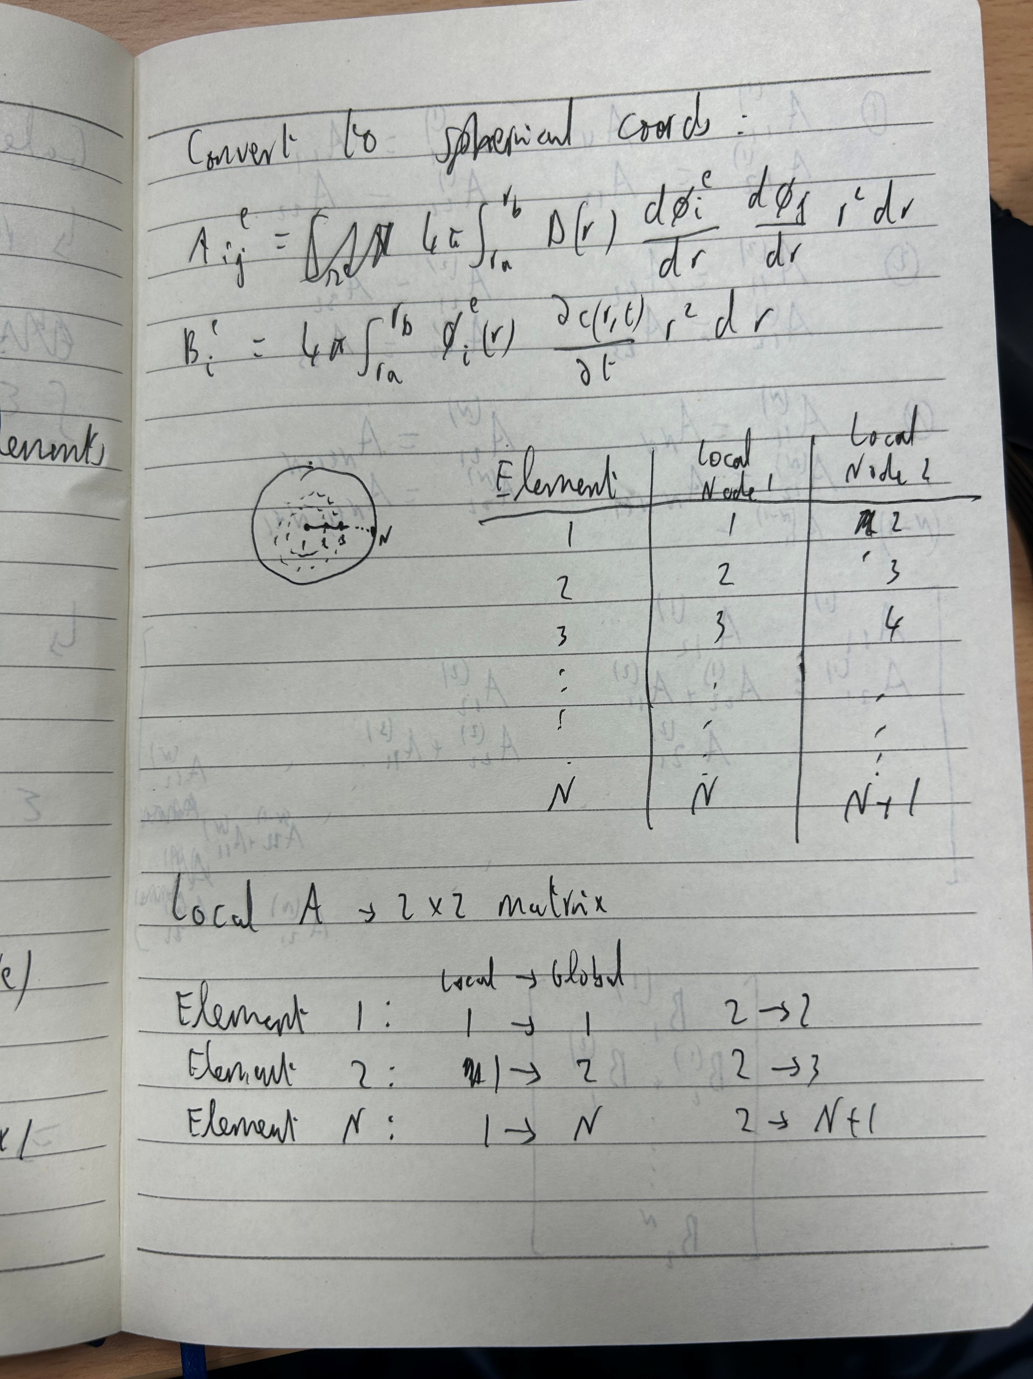
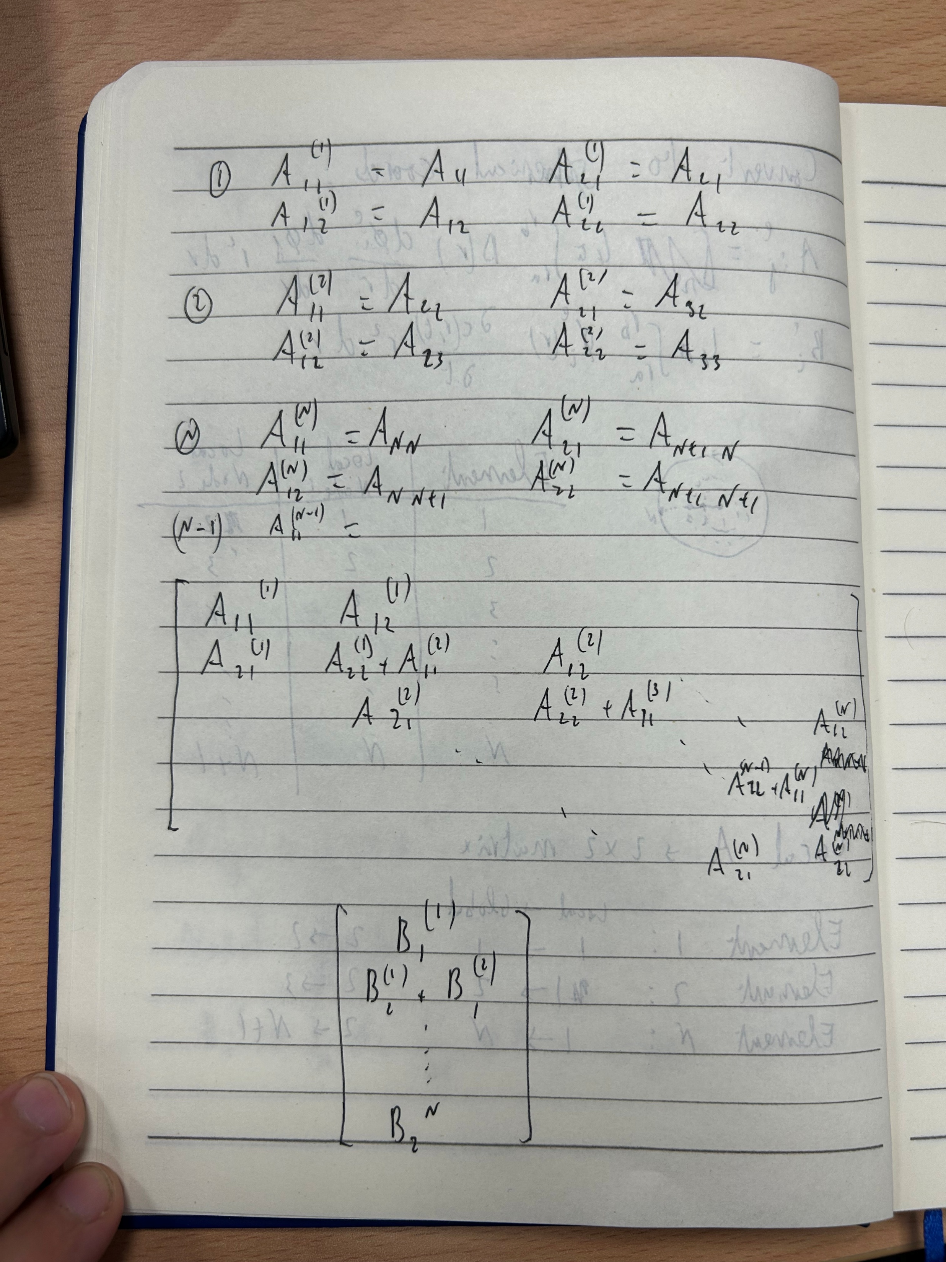
FEM-progress so far with 1D diffusion problem

Slide 3
FEM Qs
Where does Galerkin method come from? Why does it work?
Help with forming the matrix. Why exactly do we do the proper method of the assembly of the elements?

Slide 4
Kalnaus review summary
Non-uniform lithium deposition => cracking
Need to minimise gradients in elastic strain => zero-strain cathodes or pairing
For Li metal anodes => need to allow planar plating and stripping => challenging => improve homogeneity of plating + improve Li condition to reduce defects
Stress-relief mechanisms: deformation- inelastic or viscoelastic strain
Li metal can easily plastically deform but if in small, constrained space it can sustain much larger stresses
stress can be transferred to the SSE: if Li cannot deform sufficiently or cathode is non-uniform which leads to localised gradients in elastic strain => ceramic electrolyte will crack
Ceramics usually cannot relieve stress through plastic deformation at room temperature => introduce defects to help
Glasses can deform under repeated stress even below transition temperature => densification + shear flow => but can activate creep and produce hysteresis

Slide 5
Kalnaus review Qs
”At the critical length scale, termed the defect “danger zone,” however, the local stress can be maximized because the stressed volume is too large for efficient diffusional flow (diffusion length is too long) and yet too small to find the required number of dislocations to trigger inelastic strain by dislocation motion. The important outcome is that the stress within Li-filled interface defects in the danger zone can be orders of magnitude higher than the flow stress of bulk polycrystalline Li metal. “
=> What is the intuition here?
Why is plastic deformation an effective stress-relief mechanism in the battery? Would it not change shape of battery?
What is the effect of Li metal ability to withstand high stresses locally?
Why does dislocation allow for plastic deformation?

